Slide 1
Strength from Within:
Building a Strong Spirit

Slide 2
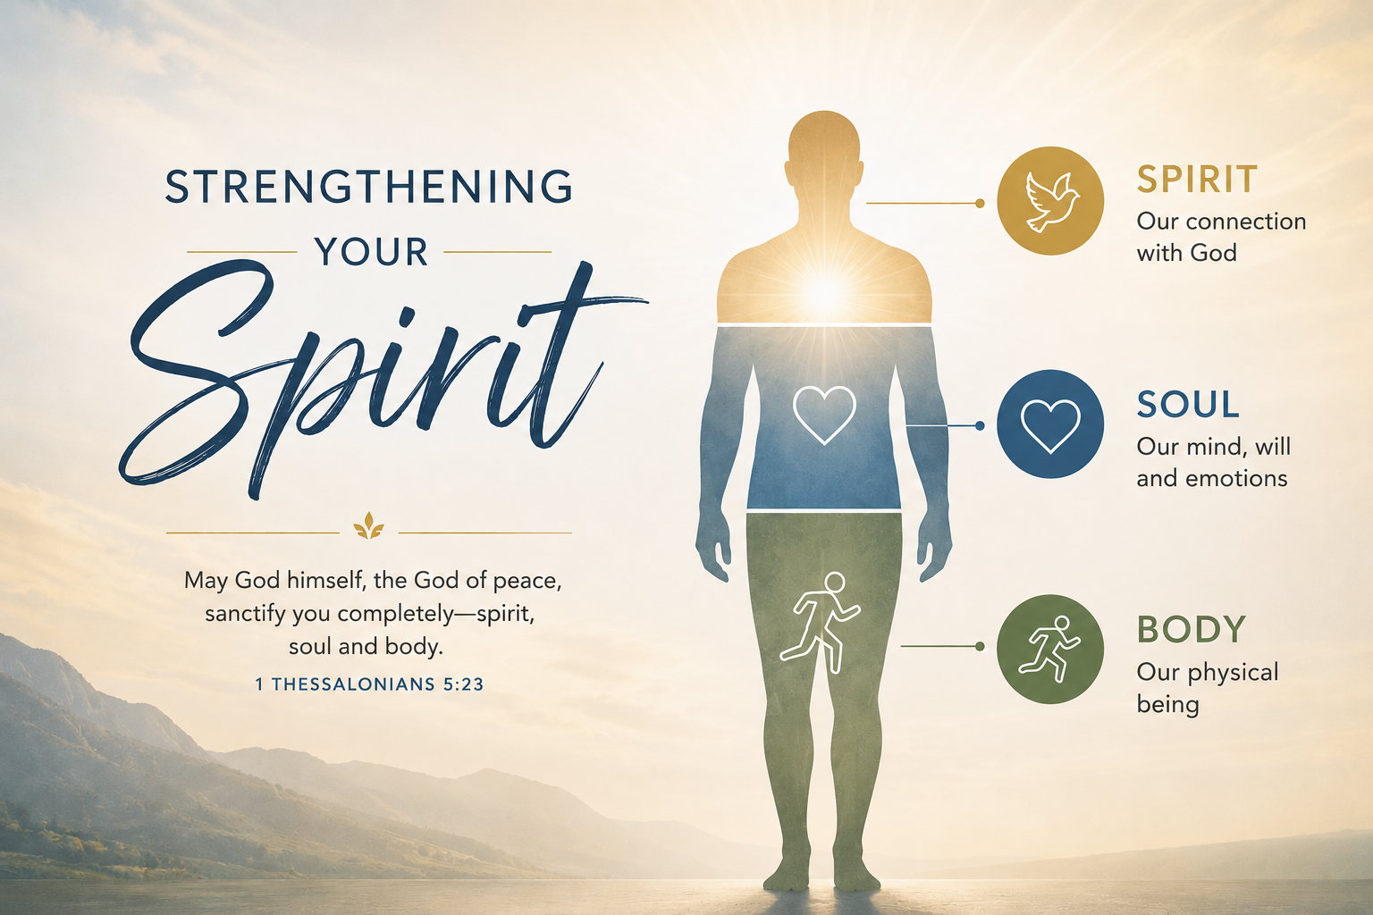

Slide 3
God’s Word
Avoiding a Sinful Lifestyle
Walking in the Spirit
Prayer
Obedience to God’s directions
Guarding our hearts

Slide 4
Real strength is not outward.
Real strength is inward.

Slide 5
A man’s spirit will endure sickness, but a crushed spirit who can bear?
Proverbs 18:14

Slide 6


Slide 7
How strong is your spirit?

Slide 8
Now may the God of peace himself sanctify you completely, and may your whole spirit and soul and body be kept blameless at the coming of our Lord Jesus Christ.
1 Thessalonians 5:23

Slide 9
Now may the God of peace himself sanctify you completely, and may your whole spirit and soul and body be kept blameless at the coming of our Lord Jesus Christ.
1 Thessalonians 5:23

Slide 10
The spirit of man is the lamp of the Lord, searching all his innermost parts.
Proverbs 20:27

Slide 11
The Spirit himself bears witness with our spirit that we are children of God.
Romans 8:16

Slide 12
… that according to the riches of his glory he may grant you to be strengthened with power through his Spirit in your inner being, so that Christ may dwell in your hearts through faith....
Ephesians 3:16-17

Slide 13
By sorrow of heart the spirit is crushed.
Proverbs 15:13

Slide 14
God’s Word
“It is written, “‘Man shall not live by bread alone, but by every word that comes from the mouth of God.’”
Matthew 4:4

Slide 15
Living a sinful lifestyle
weakens our spirit.
Avoiding such a lifestyle
Strengthens the spirit.

Slide 16
Walk in the Spirit
But I say, walk by the Spirit, and you will not gratify the desires of the flesh.
Galations 5:16

Slide 17
Prayer
1 Thessalonians 5:17 says:
“Pray without ceasing.”

Slide 18
Obedience to God’s Directions.
If any of you lacks wisdom, let him ask God, who gives generously to all without reproach, and it will be given him.
James 1:5

Slide 19
Guard our Hearts
(our inner spirit)
Keep your heart with all vigilance, for from it flow the springs of life.
Proverbs 4:23

Slide 20
My flesh and my heart may fail, but God is the strength of my heart and my portion forever.
Psalm 73:26

Slide 21
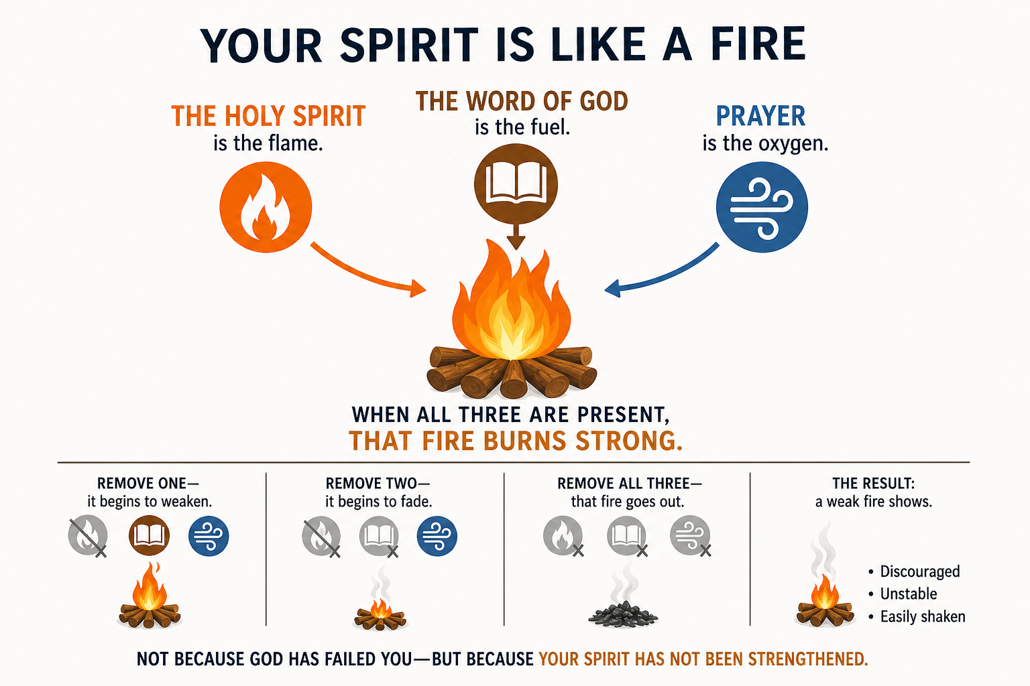

Slide 22
Big Idea:
True strength does not begin on the outside—it begins within. We are spirit, soul, and body, and it is our spirit that connects with God. When our spirit is weak, we are led by emotions and easily shaken by circumstances. When our spirit is strengthened through God’s Word, prayer, and obedience, we become steady and resilient. God’s Spirit works within us to guide, correct, and sustain us, enabling us to endure hardship and live faithfully from the inside out.

