Slide 1
What does God see?

Slide 2
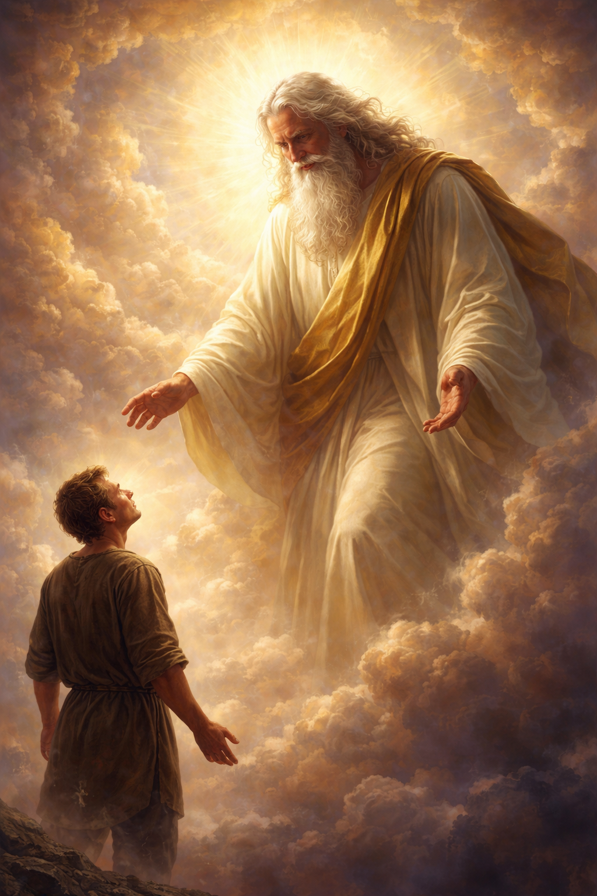

Slide 3
““Then he showed me Joshua the high priest standing before the angel of the LORD, and Satan standing at his right hand to accuse him. And the LORD said to Satan, ‘The LORD rebuke you, O Satan! The LORD who has chosen Jerusalem rebuke you! Is not this a brand plucked from the fire?’

Slide 4
Now Joshua was standing before the angel, clothed with filthy garments. And the angel said to those who were standing before him, ‘Remove the filthy garments from him.’ And to him he said, ‘Behold, I have taken your iniquity away from you, and I will clothe you with pure vestments.’

Slide 5
And I said, ‘Let them put a clean turban on his head.’ So they put a clean turban on his head and clothed him with garments. And the angel of the LORD was standing by.”“

Slide 6
What does God see when He looks at you?

Slide 7
How can I go to God
when I know I’m not clean?

Slide 8
Now Joshua was standing before the angel, clothed with filthy garments.
Zechariah 3:3

Slide 9
…and Satan standing at his right hand to accuse him.
Verse 1

Slide 10
GOD DOES NOT ARGUE WITH THE ACCUSER

Slide 11
“And the LORD said to Satan, ‘The LORD rebuke you, O Satan!
Verse 2
“Is not this a brand plucked from the fire?”

Slide 12
“Remove the filthy garments from him.”
“Behold, I have taken your iniquity away from you, and I will clothe you with pure vestments.”

Slide 13
WHAT THIS VISION TEACHES US

Slide 14
For our sake He made him to be sin who knew no sin, so that in Him we might become the righteousness of God.
2 Corrinthians 5:21

Slide 15
WHAT DOES GOD SEE
WHEN HE LOOKS AT A SAVED PERSON?

Slide 16
“There is therefore now no condemnation for those who are in Christ Jesus.
Romans 8:1
No condemnation.

Slide 17
“He who began a good work in you will bring it to completion at the day of Jesus Christ.”
Philippians 1:6

Slide 18
“For sin will have no dominion over you, since you are not under law but under grace.”
Romans 6:14

Slide 19
“As a father shows compassion to his children, so the LORD shows compassion to those who fear Him. For He knows our frame; He remembers that we are dust.”
Psalms 103:13-14

Slide 20
“But if we walk in the light, as he is in the light, we have fellowship with one another, and the blood of Jesus his Son cleanses us from all sin.”
1 John 1:7

Slide 21
How can I go to God
when I know I’m dirty?

Slide 22
“Let us then with confidence draw near to the throne of grace, that we may receive mercy and find grace to help in time of need.”
Hebrews 4:16

Slide 23
“And you, who were dead in your trespasses and the uncircumcision of your flesh, God made alive together with him, having forgiven us all our trespasses, by canceling the record of debt that stood against us with its legal demands. This he set aside, nailing it to the cross.”
Colossians 2:13-14

Slide 24
So, what does God see
when He looks at you?

Slide 25
“As far as the east is from the west, so far does he remove our transgressions from us.”
Psalms 103:12

Slide 26
Our Big Idea:
When we fail and sin, God does not see our sin as a condemnation of us or a reason to abandon us. For those who trust in Christ, God sees a saved, redeemed, and clean child of God, saved by the blood of Jesus Christ.

