Slide 1
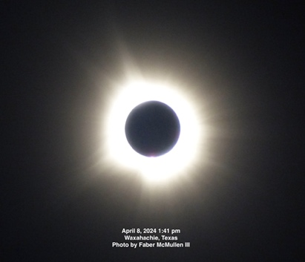

Slide 2
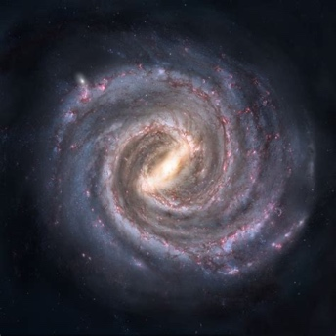
Closest Star – Proxima Centauri – 40 Trillion Miles Away
Milky Way – 200-400 Billion Stars
Two Hundred Billion Trillion Stars in the “Observable Universe”
https://commons.wikimedia.org/wiki/File:Messier51_sRGB.jpg

Slide 3
Encouragement is a BIG DEAL in the Church
“¹¹ Therefore comfort each other and edify one another, just as you are doing.(1 Thessalonians 5:11 NKJV)

Slide 4
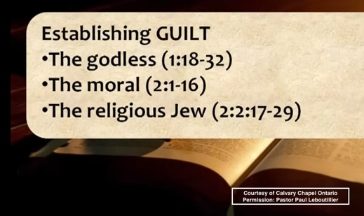

Slide 5

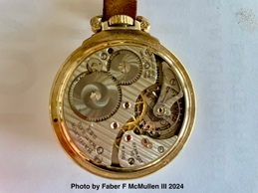

Slide 6
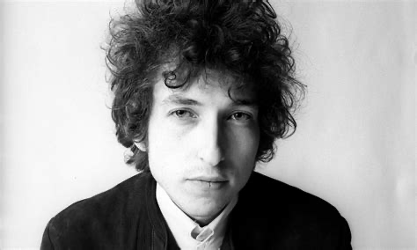
You’ve Gotta Serve Somebody by Bob Dylan
[Verse 6]
[you] Might like to wear cotton, might like to wear silk
Might like to drink whiskey, might like to drink milk
You might like to eat caviar, you might like to eat bread
You may be sleeping on the floor, sleeping in a king-sized bed
[Chorus]
But you’re going to have to serve somebody, yes indeed
You’re going to have to serve somebody
Well, it may be the devil or it may be the Lord
But you’re going to have to serve somebody
Bob Dylan – Special Rider Music 1979
https://www.ecosia.org/images?q=Bob+Dylan&license=share

Slide 7
Practical Advice Concerning Godlessness
1 Don’t argue with people about whether or not they were born “that way”.
2 If you hate homosexuals or people living in licentious lifestyles you need to repent.
3 We are free from the bondage of sin.

Slide 8
^{HEBREWS 4:15-16} For we do not have a High Priest who cannot sympathize with our weaknesses, but was in all points tempted as we are, yet without sin. ¹⁶ Let us therefore come boldly to the throne of grace, that we may obtain mercy and find grace to help in time of need.

Slide 9
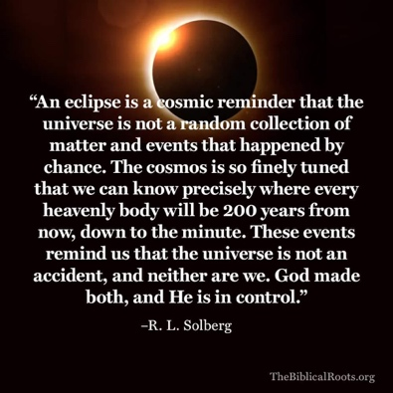

Slide 10
“The heavens declare the glory of God; and the firmament sheweth his handywork.” (Psalm 19:1 KJV)

