Slide 1
DISCIPLES OF LIGHT IN A WORLD OF DARKNESS

Slide 2
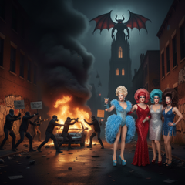

Slide 3
Take no part in the unfruitful works of darkness, but instead expose them.
Ephesians 5:11

Slide 4
There are only two kingdoms:
The Kingdom of God
&
The kingdom of Satan
Whoever is not with me is against me, and whoever does not gather with me scatters.
Matthew 12:30

Slide 5
You are of your father the devil, and your will is to do your father’s desires. He was a murderer from the beginning, and does not stand in the truth, because there is no truth in him.
John 8:44

Slide 6
Disciple:
Think of the word “discipline”
It means follower, learner or imitator

Slide 7
Deception
Destruction
Division
Diversion

Slide 8


Slide 9
Even Satan disguises himself as an angel of light. So it is no surprise if his servants, also, disguise themselves as servants of righteousness.
2 Corinthians 11:14-15

Slide 10
Who and What Are These Disciples of Satan
Mainstream or Legacy Media
Woe to those who call evil good and good evil, who put darkness for light and light for darkness.
Isaiah 5:20

Slide 11
Who and What Are These Disciples of Satan
Agencies That Promote Abortion
For you formed my inward parts; you knitted me together in my mother's womb. I praise you, for I am fearfully and wonderfully made..
Psalms 139:13-14

Slide 12
Who and What Are These Disciples of Satan
Movements That Promote Transgenderism
For God is not a God of confusion but of peace.
1 Corinthians 14:33

Slide 13
Who and What Are These Disciples of Satan
Voices of Hate & Division
Now the works of the flesh are evident: sexual immorality, impurity, sensuality, idolatry, sorcery, enmity, strife, jealousy, fits of anger, rivalries, dissensions, divisions…
Galations 5:19-20

Slide 14
How do we respond?
Expose the Darkness
Take no part in the unfruitful works of darkness, but instead expose them.
Ephisians 5:11

Slide 15
How do we respond?
Stand Firm in the Word
Your word is a lamp to my feet and a light to my path.
Psalms 119:105

Slide 16
How do we respond?
Live as The Light of the World
You are the light of the world. A city set on a hill cannot be hidden.
Matthew 5:14

Slide 17
How do we respond?
Pray for Deliverance
We do not wrestle against flesh and blood, but against the rulers, against the authorities, against the cosmic powers over this present darkness.
Ephesians 6:12

Slide 18
What is our Final Victory?
The devil who had deceived them was thrown into the lake of fire and sulfur… and they will be tormented day and night forever and ever.
Revelation 20:10

Slide 19
The kingdom of the world has become the kingdom of our Lord and of his Christ, and he shall reign forever and ever.
Revelation 11:15

Slide 20
Every person must answer one question:
Whose disciple am I?
Am I following Christ?
Or
Am I following Satan?

Slide 21
Do not repay evil for evil or reviling for reviling, but on the contrary, bless, for to this you were called, that you may obtain a blessing.
1 Peter 3:9

Slide 22
Repay no one evil for evil, but give thought to do what is honorable in the sight of all. If possible, so far as it depends on you, live peaceably with all. Beloved, never avenge yourselves, but leave it to the wrath of God, for it is written, ‘Vengeance is mine, I will repay, says the Lord.’
Romans 12:17-19

Slide 23
See that no one repays anyone evil for evil, but always seek to do good to one another and to everyone.
1 Thessalonians 5:15

Slide 24
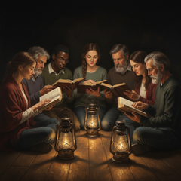

Slide 25
THE BIG IDEA!
• When someone speaks harshly, respond with gentleness.
• When you are wronged, pray for that person rather than plotting against them.
• When bitterness rises in your heart, remember the cross—and the grace you yourself have received.

